Slide 1
MCSD51: Certificate in Introductory Software Development Level 5
Part 2:
Product Implementation

Slide 2
Password Generator
Maribeth Estimos
Xian (Richard) Zhang
Zhengwen (Steven) Lei

Slide 3
Agenda
1. What is a Password Generator
2. Why we chose this project
3. Technologies
4. Methodology
5. Team work
6. Reflections
7. References
8. Demo
9. Q & A

Slide 4
What is A Password Generator?
Create a random password for use when registering or changing passwords in websites and apps
Platforms:
Computers/Laptops (Mac & Windows), phones (IOS & Android), tablets (ipads & other brands)

Slide 5
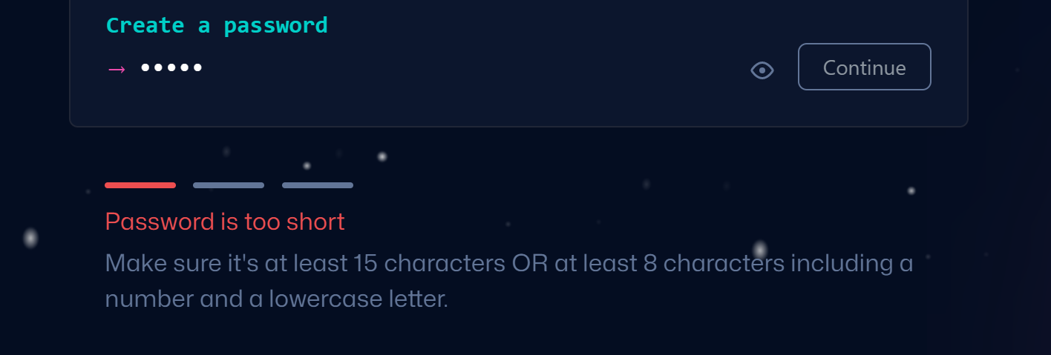
Why we chose this project?
Hard to create a complex password

Slide 6
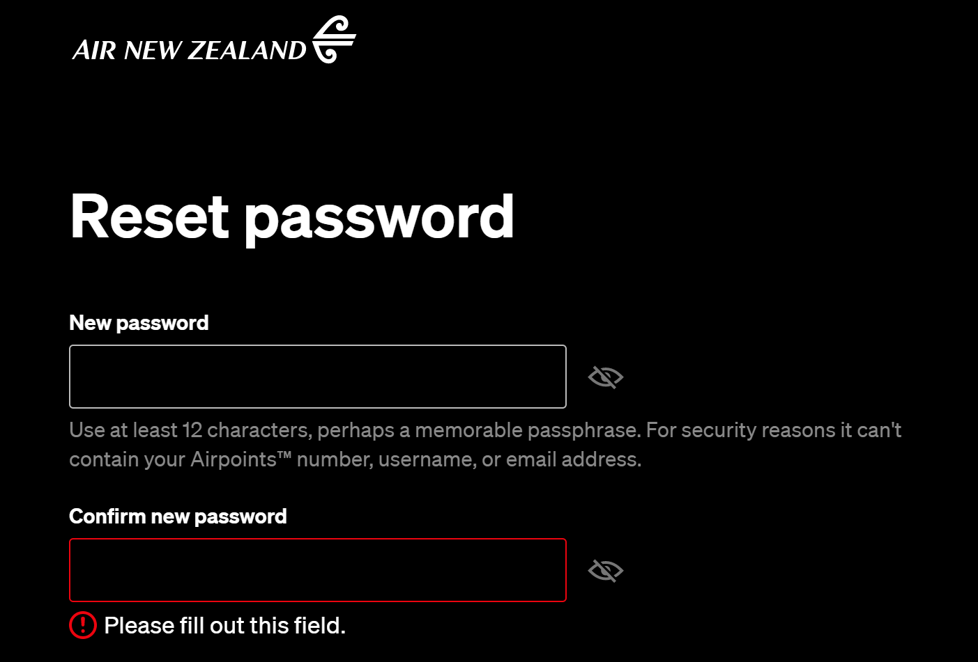
Why we chose this project?
Hard to create a complex password

Slide 7
Why we chose this project?
Users often create simple passwords like these;
123456,1234567890
qwert, qweryuiop
123456qwerty, 1qaz2wsx

Slide 8
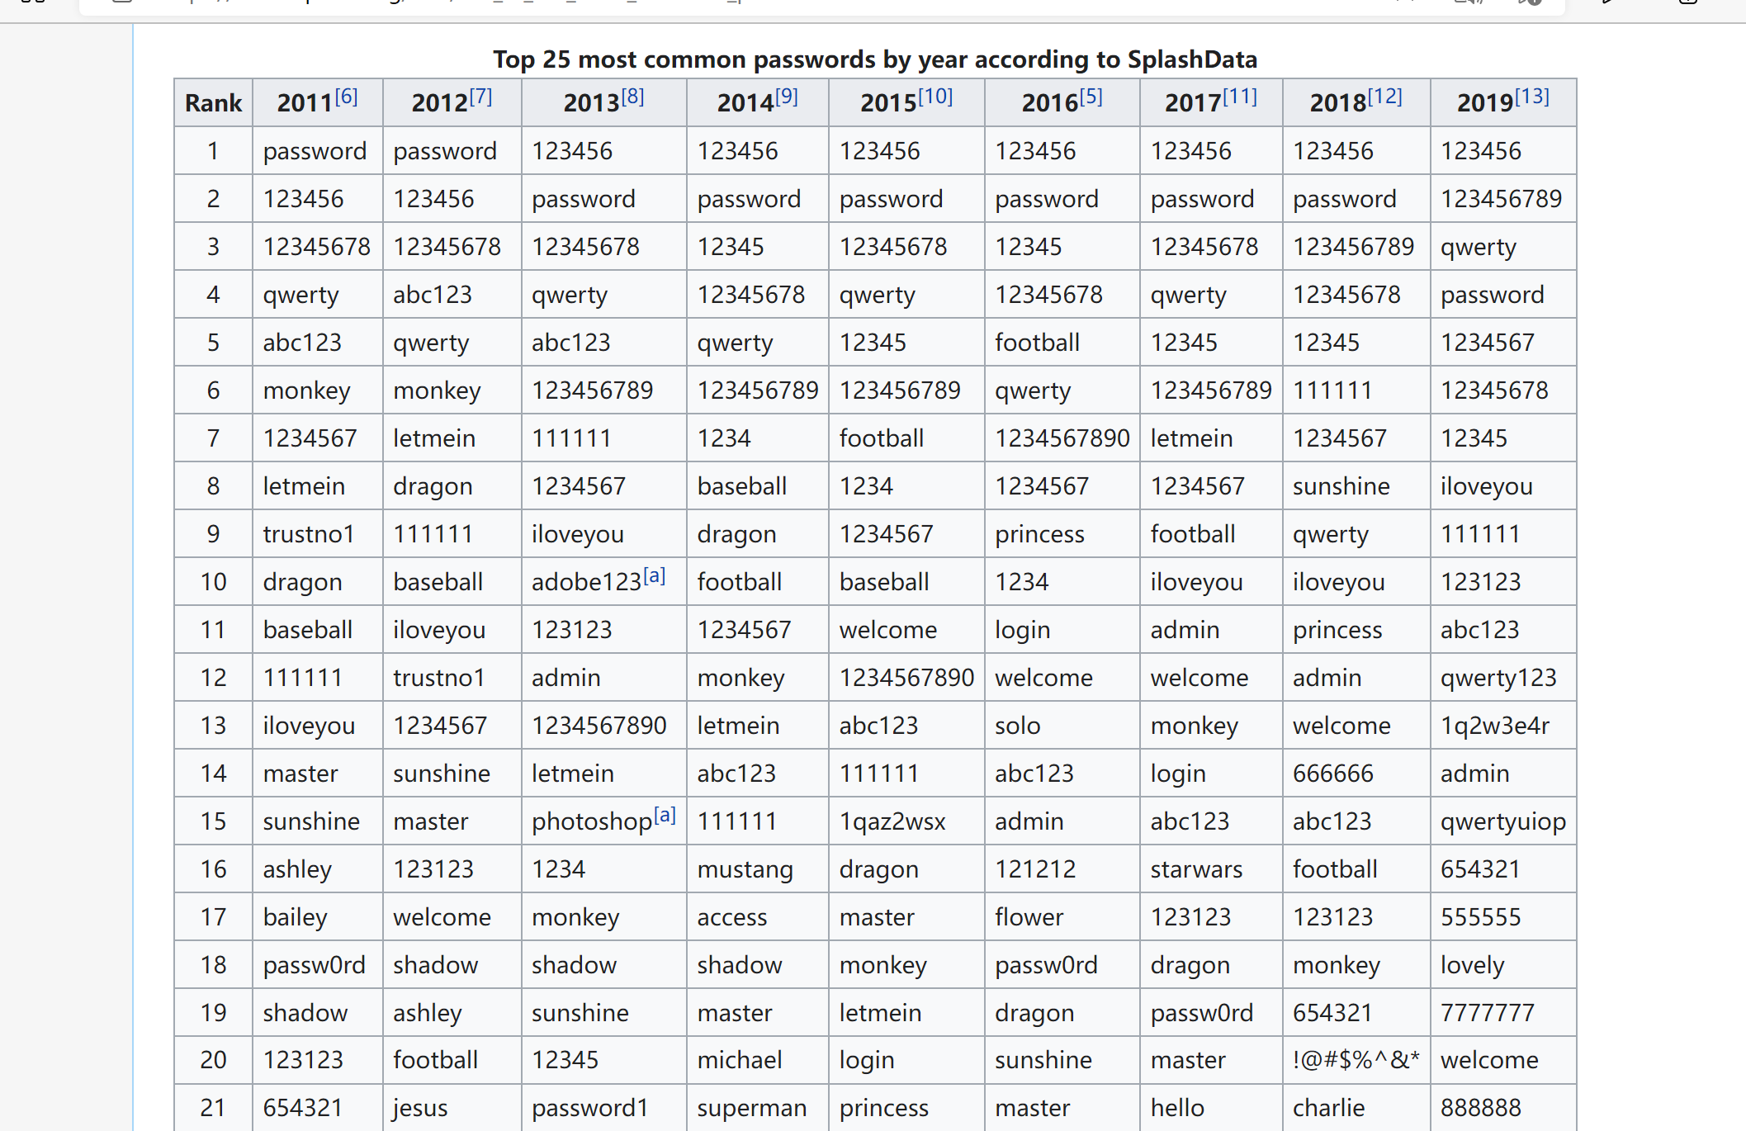
Retrieved from: List of the most common passwords - Wikipedia

Slide 9
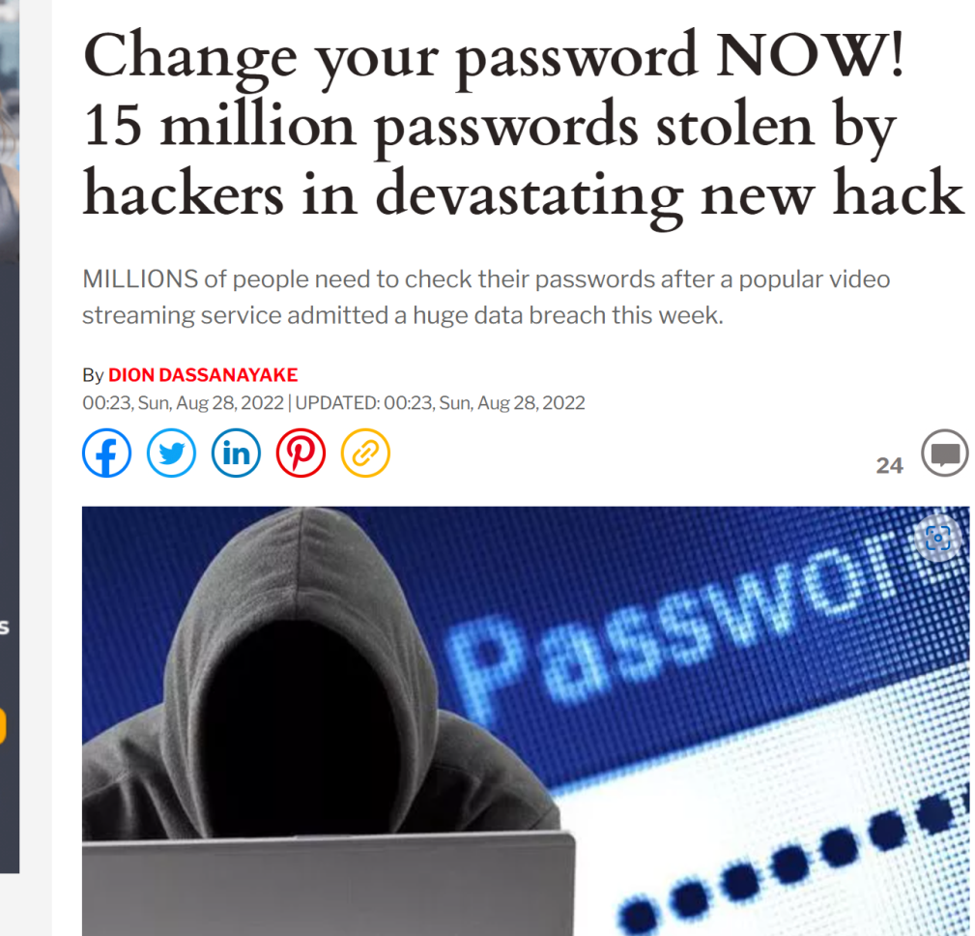
Risks of password leaking
1. Private information exposure
2. Money loss
3. Risks of ID frauds
Retrieved from: Change your password NOW! 15 million Plex passwords stolen by hackers | Express.co.uk

Slide 10
Technologies Used
Web-based software
Tools: Apache, Nodejs
Modules: express, ejs, cookie-parser
Languages: Javascript, Javascript( embedded ), HTML, CSS
Request method: POST / GET

Slide 11
methodology
4 reasons for using waterfall methodology
The requirements are clear.
Relatively simple system.
Only used in certain circumstances
Unlikely to be changed.
1. Allow input of various input parameters on password such as Password Length, Include Special Characters, Numbers, Lower/Upper case Characters
2. Save the settings for future use
3. Generate a random password based on the above parameters
4. Copy function to copy the generated password to the buffer (like Control + C)
Retrieved from: Project list

Slide 12
TEAM WORK
Client (Richard)
User Interface (HTML/ejs, CSS, embedded javascript)
Server (Steven)
request process (javascript)
Cookies process (javascript)
Server( Maribeth)
implement a module for Password Generator (javascript)

Slide 13
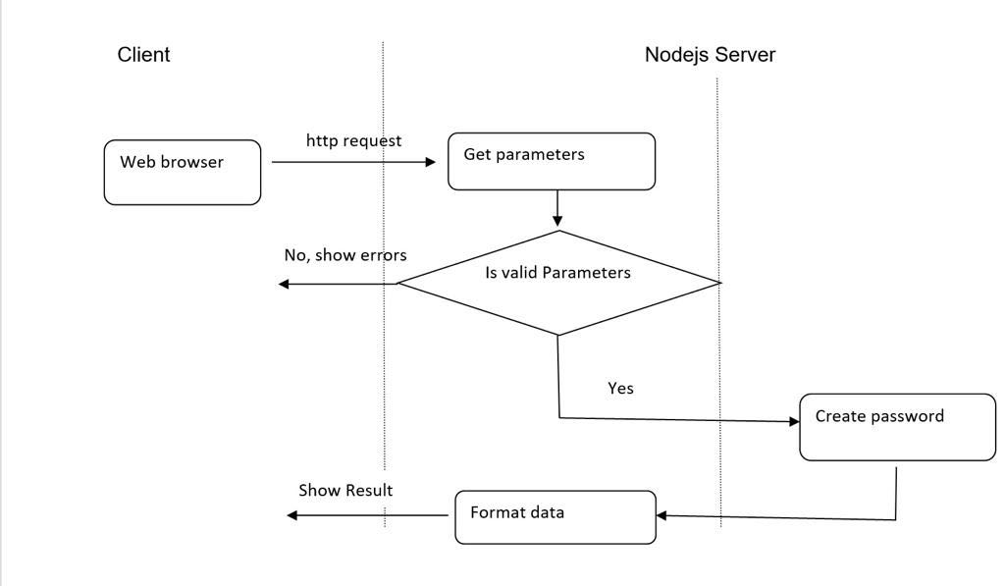
TEAM WORK

Slide 14
Reflections
Maribeth: As I sit down to reflect on my learning journey at Future Skills Academy, I must say that it was a positive one. Working in a totally different field was such a challenge to begin with. I have no clue about the tools, modules and languages and even felt overwhelmed, finding out that we need to create a program as part of our project. Thankfully, I was put in a group where my team will always check if I needed help and has been very supportive from day 1 up to the final stage. We worked closely just to ensure that we are all in the same page. By doing this project, I gained the knowledge how to use basic CSS, HTML and JavaScript. I also learnt about User Story and Use Cases. It is no secret that there is much more to learn on my end. Learning environment is amazing; lecturers are very supportive and willing to extend help as much as they could.
Richard:
Steven:

Slide 15
References

Slide 16
Q&A
Answer Questions

